Slide 1

Data analysis of the Video Assistant Referee (VAR) in the Bundesliga

Slide 2
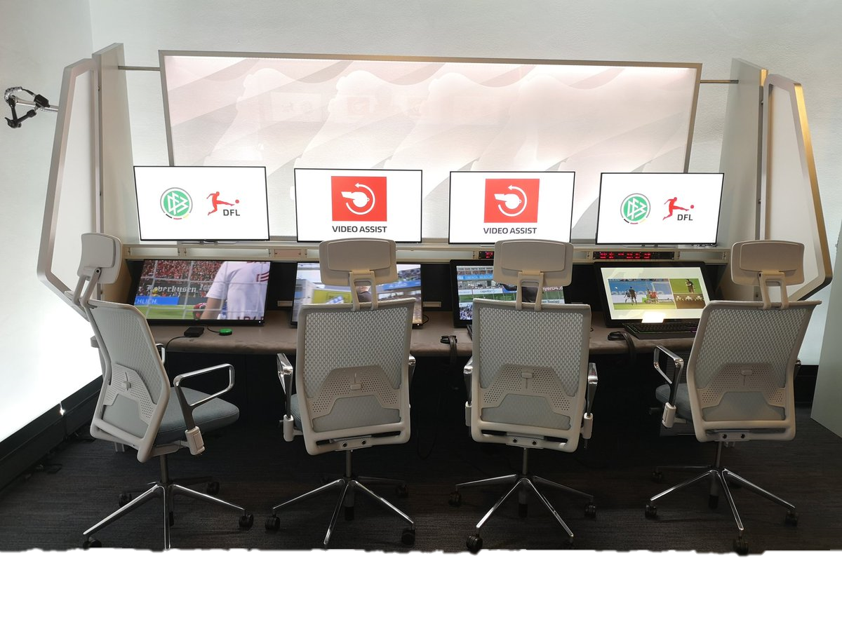




Agenda

Slide 3



Slide 4
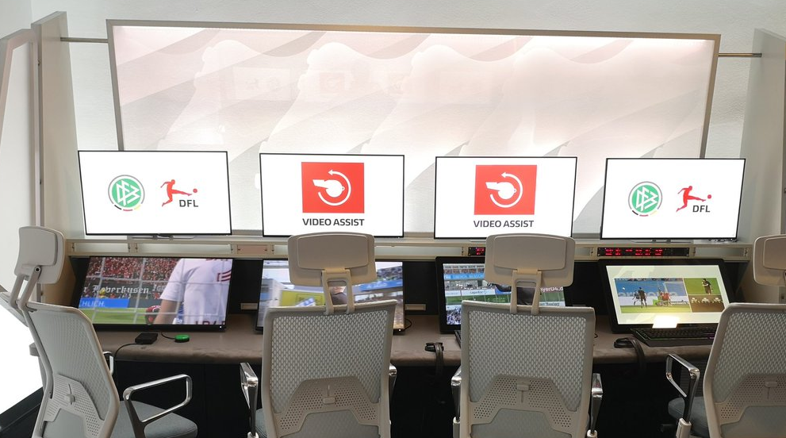
Introduction
Video Assistant Referee was introduced to the German Bundesliga in the season 2017/2018
Prior to introduction there was an intensive test period
The costs of the VAR:
~ 2900 € per match (1. League)
~ 590 € per match (2. League)
Our analysis is addressing the German Womens‘ Bundesliga

Slide 5
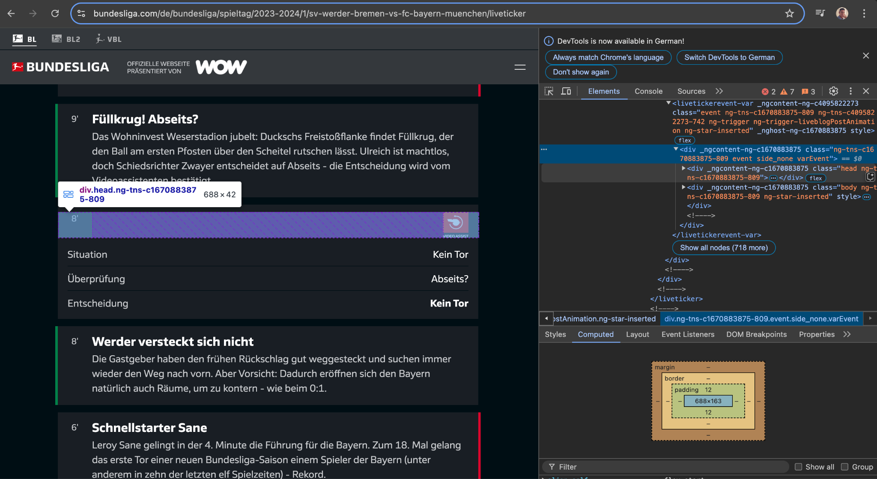
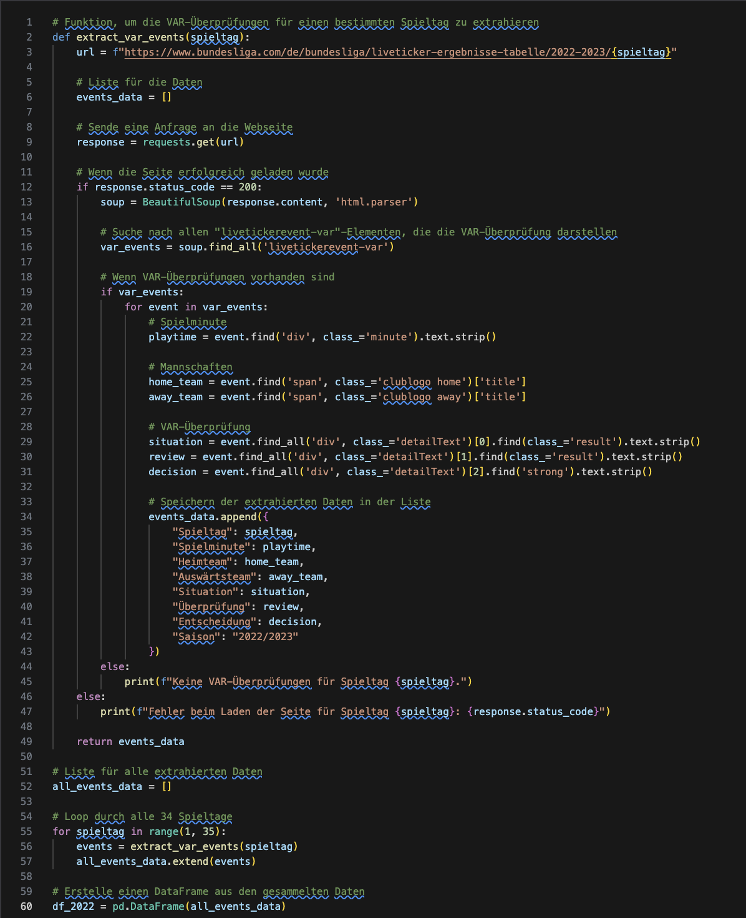





Data loading
Our data consists of…
5 different sources
Approx. 3.000 URLs
18 different tables
Approx. 67 Tsd. rows
Research on over 250 websites

Slide 6
Research Questions
Has the VAR impacted the error rate of referees’ decision?
Is the frequency of VAR-relevant match situations changing?
Does the use of VAR influence the decision-making behavior of referees?
Has the frequency of VAR interactions changed over time?
Which situations have been reviewed the most?
Do the trends in the top European leagues differ since the introduction of VAR?

Slide 7
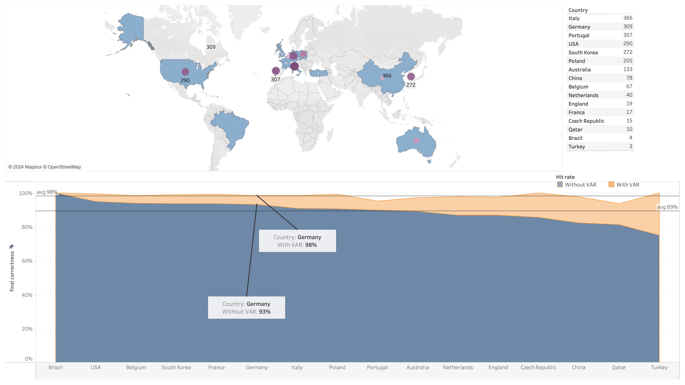
VAR - Test period

Slide 8
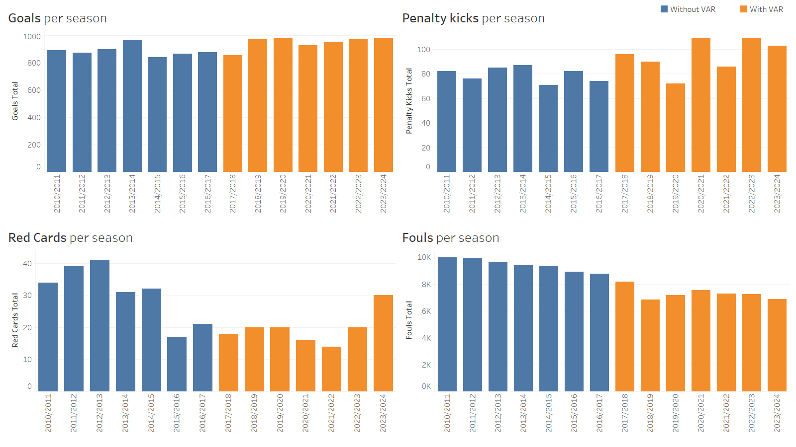
Frequency of VAR-relevant situations

Slide 9
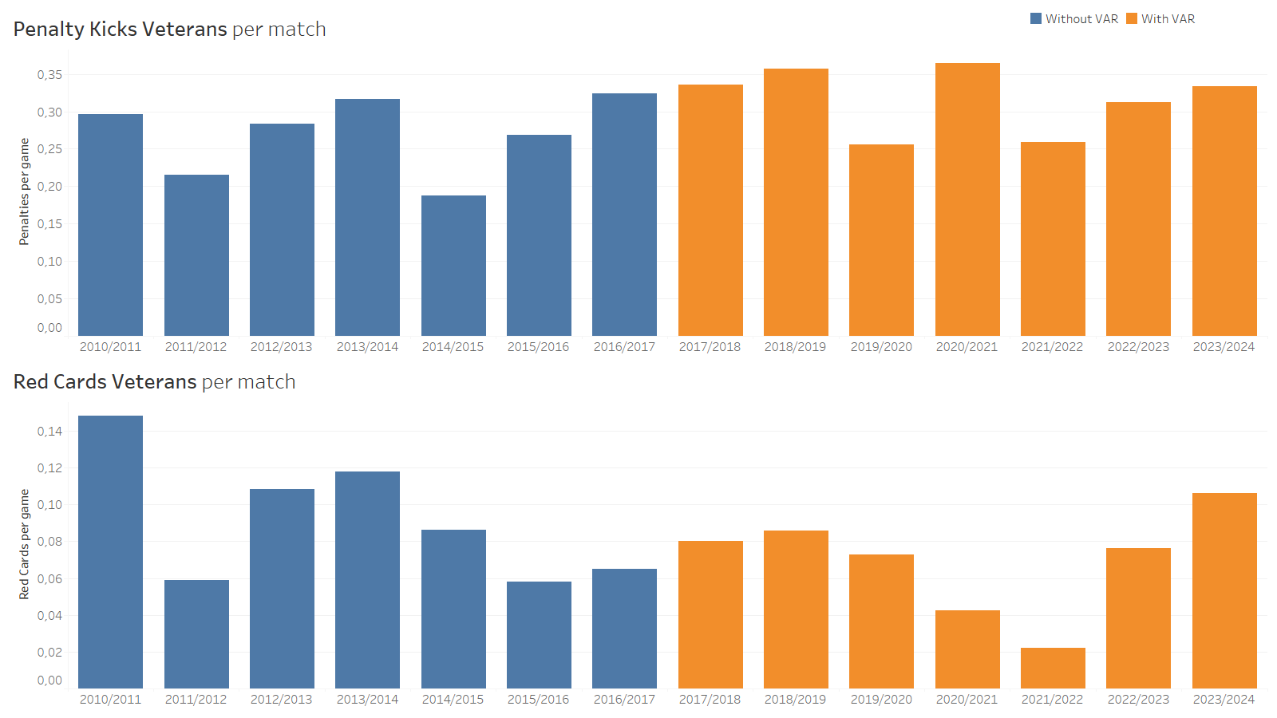
Influence on decision-making

Slide 10
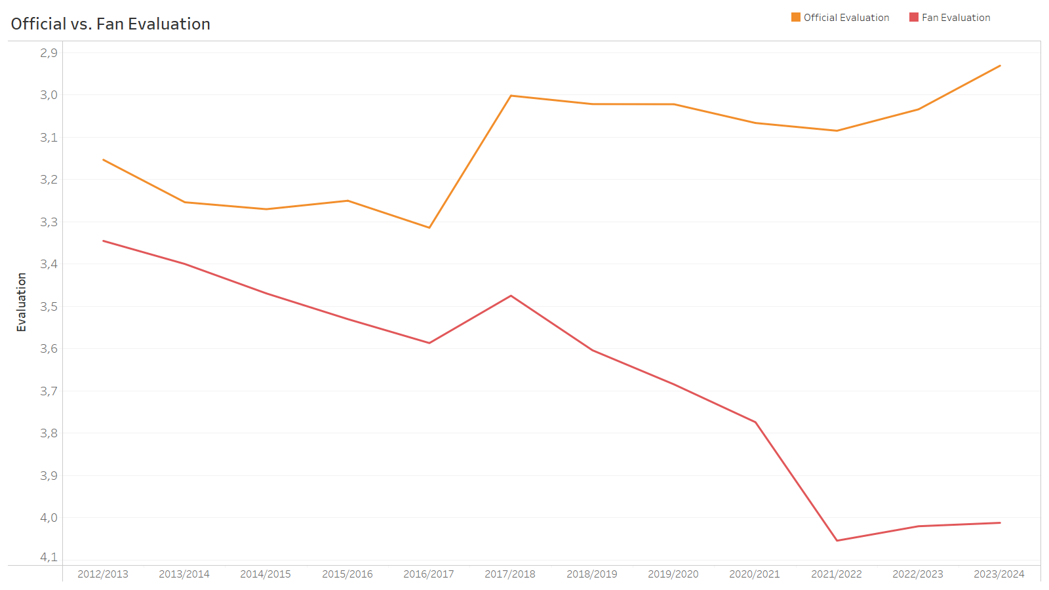
Referees‘ evaluation differs

Slide 11
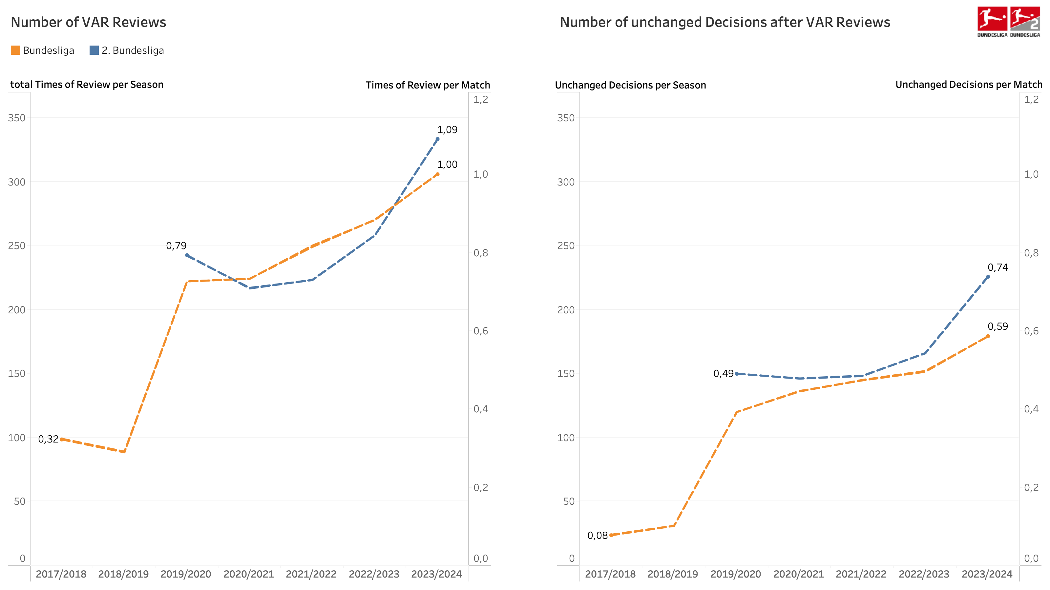
Frequency of VAR interactions

Slide 12
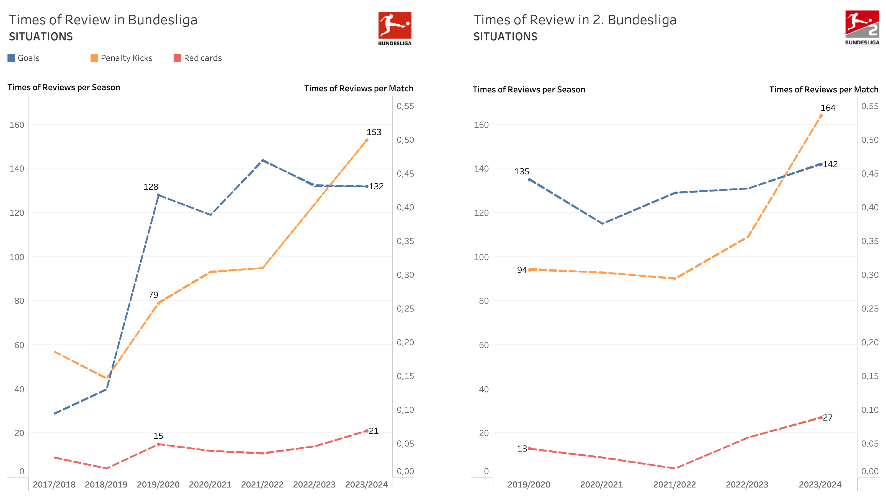
Frequency of different situations

Slide 13
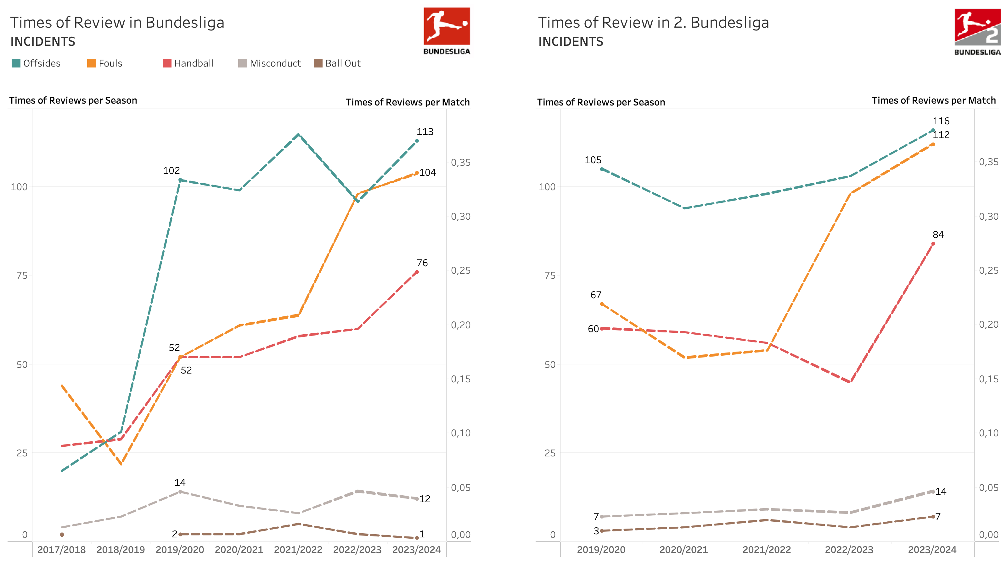
Frequency of different incidents

Slide 14
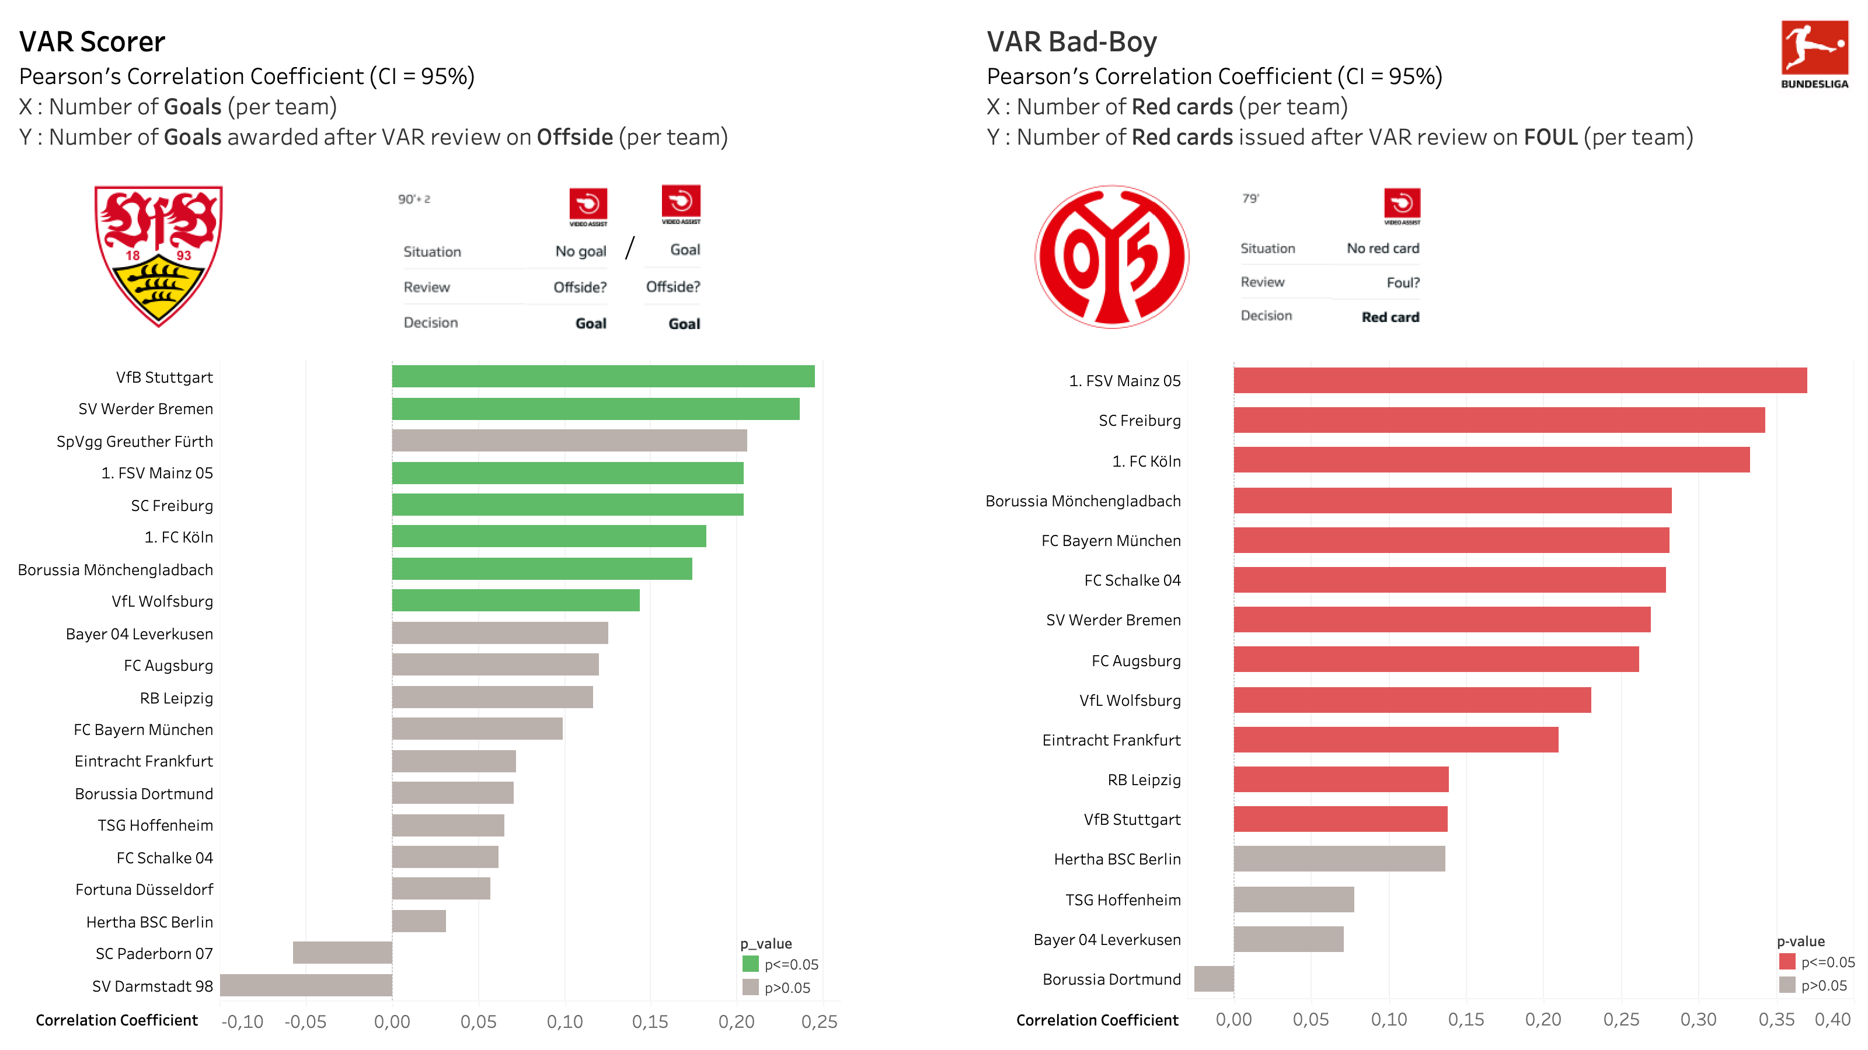
VAR-Scorer vs. VAR-Bad Boys

Slide 15
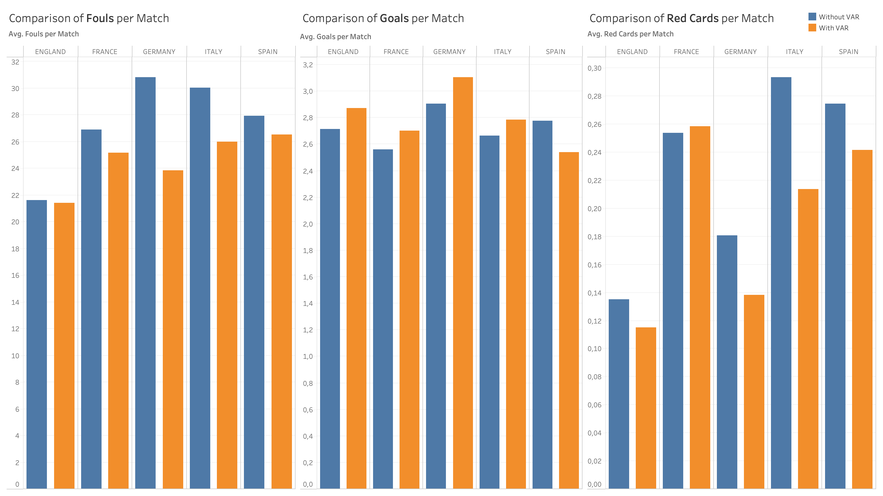
VAR in European top leagues

Slide 16
Conclusion
Answering our research questions:
The error rate of referees is lower
Bundesliga is facing more goals, less red cards & fouls, penalties remain constant
VAR does not influence the referees’ decision-making behavior
The use of VAR has increased, and decisions get revised less often
The check of offside after scoring a goal has been reviewed the most
We see similar developments in Europe’s top leagues
Similar results as official DFL data
Changes in the regulations have a direct impact on VAR data
VAR remains a controversial topic due to football’s subjectivity in match situations

Slide 17

Thanks a lot for your attention!
We are looking forward to meeting you in the breakoutroom ☺

